Slide 1
GIT TRAINING
Free Fresher’s Workshop

Slide 2


Slide 3
What is Version Control?
Notes:
Give example of company

Slide 4
What is Version Control?
Tracks changes to files over time.
A method for centrally storing files.
Allows you to revert to previous versions.
Facilitates collaboration among multiple developers.
Manages different versions and branches of code.
Essential for software development, but useful for any kind of digital project.

Slide 5




Example of VCS

Slide 6
Introduction to Git
A distributed version control system.
Created by Linus Torvalds.
Powerful, flexible, and widely used.
Open-source and free.

Slide 7
GIT Installation
Check if Git is installed or not
Git website: https://git-scm.com/downloads
Download Git

Slide 8
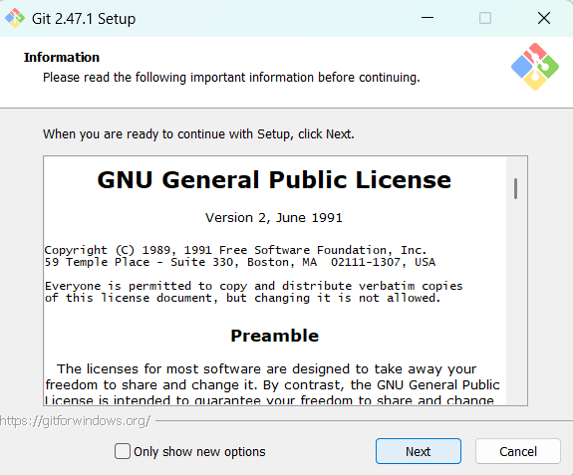
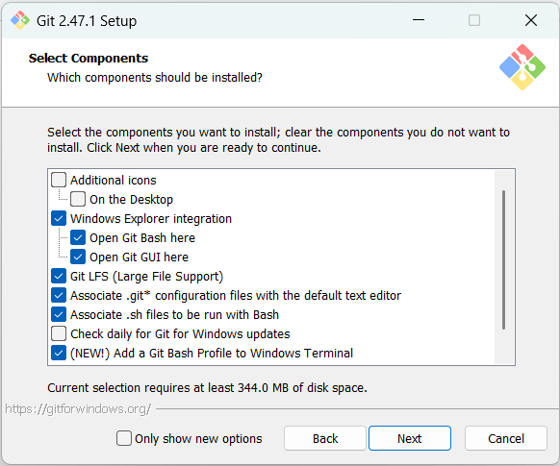
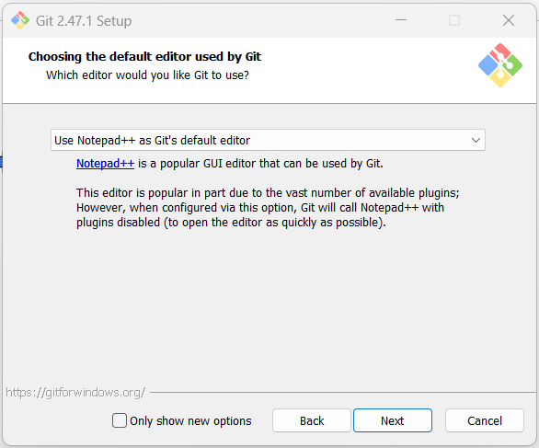
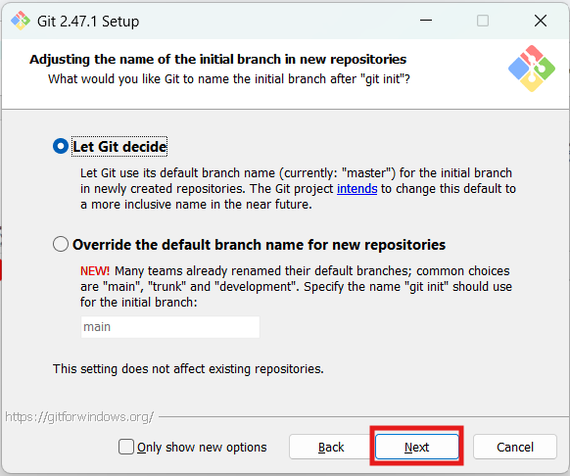
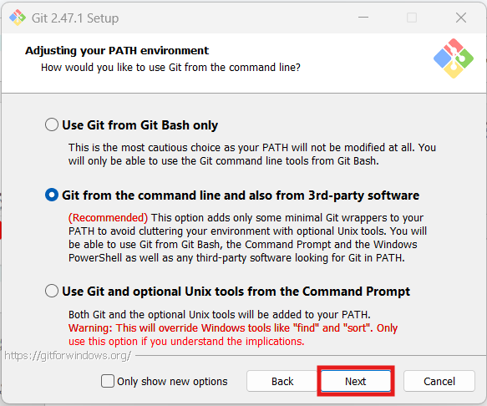
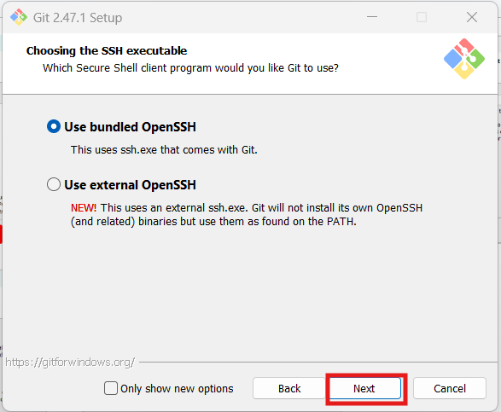
Git Installation Steps

Slide 9
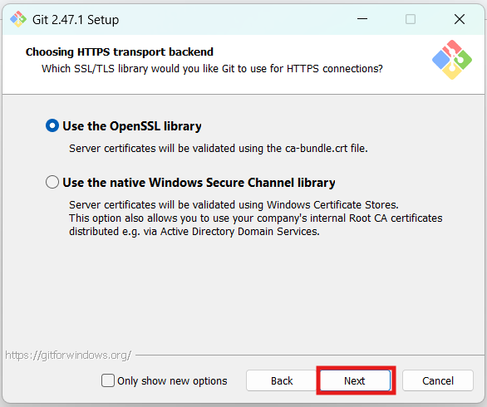
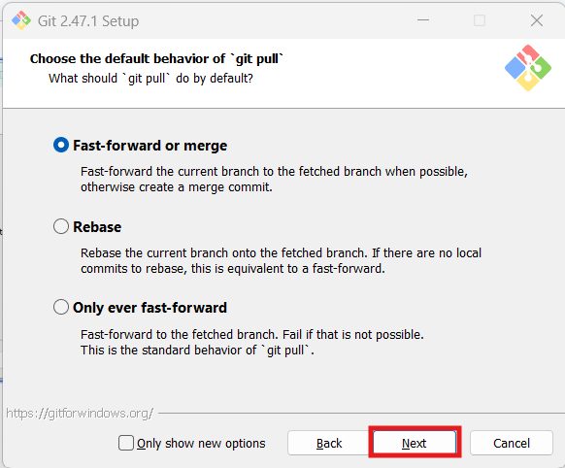
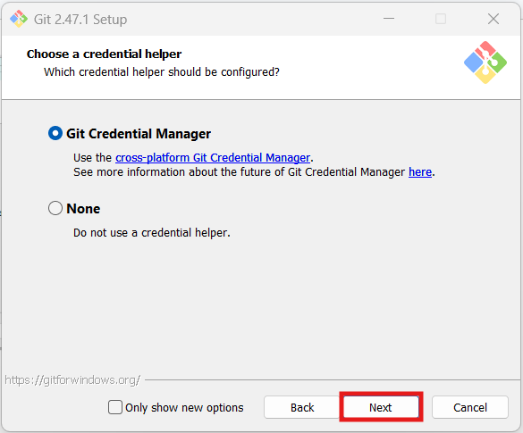
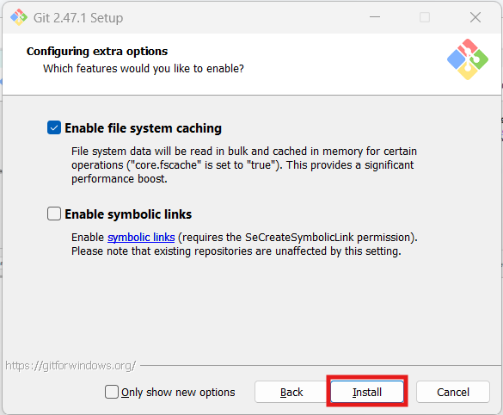
Git Installation Steps

Slide 10
Let’s Start with Git

Slide 11
Configure Git
git config --global user.name “Your Name”
git config --global user.email “your.email@example.com”
Notes:
git config --list Create workshop folder in d or c drive Then create two folders in it one Project and other Server
Now open Project folder and create new folder named GitPractice without any space Open that folder in cmd

Slide 12
git init
Initializes a new Git repository.
What is repository?
Contains Project files
Contains Change history

Slide 13
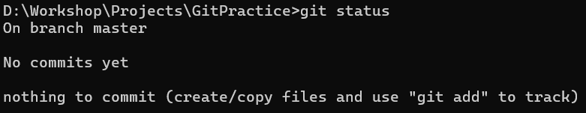
git status
Shows current status of the repository
Notes:
Show .git folder in GitPractice
git status is a very handy command for figuring our where you are and what is going on.
Create new text file named first.txt

Slide 14
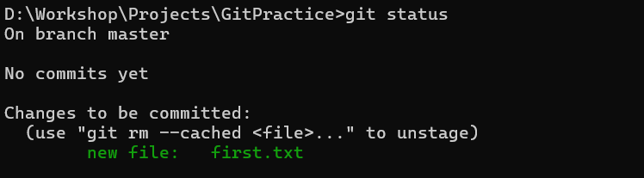
git add first.txt
Add files to the staging area(index)
git status
Shows current status of the repository
Notes:
The command git add takes the changes and moves them to the staging area

Slide 15
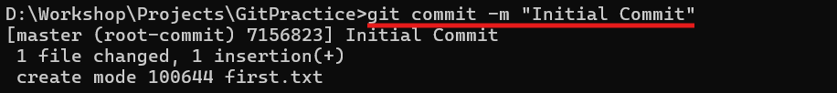
git commit -m “Initial Commit”
Create a new commit containing the current contents of the stage (index)
Notes:
Speak about what is commit
A commit is like saving your work in a video game. It takes a snapshot of your project at that moment, so you can always go back to it later. Git already automatically records
who
when
what

Slide 16
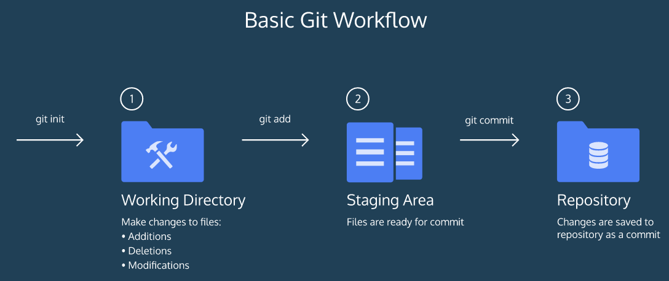
How does Git Works?

Slide 17
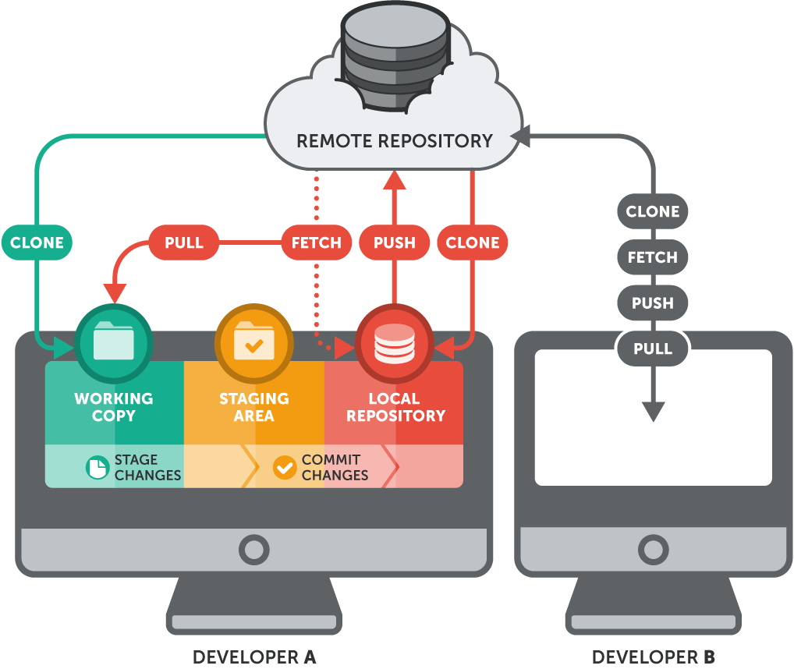
What is remote repository?
Remote repositories allow you to share your code and collaborate with others.
Notes:
A remote repository is like a shared online folder where everyone working on a project keeps the official, up-to-date version of their work. It lets people easily share changes and work together.

Slide 18
Create remote repository
git init --bare GitPractice
Creates repo without working directory so any one can push to this repo
Notes:
Change folder to server

Slide 19

git remote add origin “Path/to/remote/repo”
Check remote repository status (git remote -v)

Slide 20
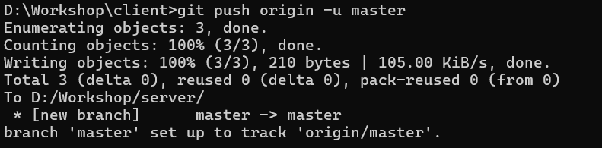
git push origin -u master

Slide 21
git clone D:/Workshop/Server/GitPractice
Notes:
Change folder for clone

Slide 22
GitHub

Slide 23
What is GitHub?
GitHub is a web-based platform built around Git
Host your Git Repository online
Enables Collaboration and sharing
Notes:
Fork repo to their account https://github.com/nilesh-darji-work/git-workshop.git

Slide 24
Fork
Create copy of someone else repository to your GitHub account
Forking allows you to experiment with changes
Your fork is entirely separate from the original.

Slide 25
Clone Repository

Slide 26

TortoiseGit

Slide 27
What is TortoiseGit?
TortoiseGit is a Windows shell extension that brings the power of Git to your fingertips through a user-friendly graphical interface.

Slide 28
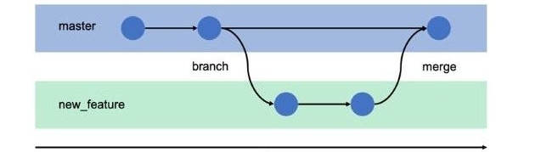
Git Branching
A parallel version of the repository.
Allows you to work on features, fixes, or experiments without affecting the main codebase.

Slide 29
Git Merge
Combines changes from one branch into another.
Merges the history of two branches.
Creates a new merge commit

Slide 30
Branch and merge

Slide 31
Pull Request (PR)
A request to merge changes from one branch into another.
Facilitates code review and collaboration before merging.
Encourages team collaboration and code quality.

Slide 32
Git Fetch
Downloads changes from a remote repository without merging them.
Updates remote-tracking branches

Slide 33
Git Pull
Fetches changes from a remote repository and merges them into the current branch.
Combines git fetch and git merge in one command.

Slide 34
Thank you

